Slide 1
SOLTRAIN
The way forward
Werner Weiss AEE - Institute for Sustainable Technologies (AEE INTEC) A-8200 Gleisdorf, Feldgasse 19 AUSTRIA

Slide 2
Outlook to SOLTRAIN – Phase III

Slide 3
SOLTRAIN – Phase III
Phase III: March 2016 – July 2019

Slide 4
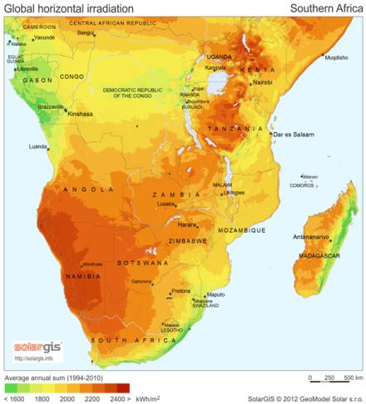
SOLTRAIN – Six Partner Countries

Slide 5
SOLTRAIN – New Partner Institutions
New project partners:
University of Botswana
SANEDI replaces SESSA in South Africa
Empresa Nacional de Parques de Ciência e Tecnologia E.P. (ENPCT, E.P.) replaces UEM in Mozambique

Slide 6
SOLTRAIN – Six Partner Countries

Slide 7
SOLTRAIN – Work Package Structure

Slide 8
Expected Results
12 Policy Workshops with 250 participants carried out
500 persons trained in 22 training courses on design, installation and maintenance of solar thermal systems
3 national Solar Thermal Roadmaps developed in stakeholder processes for Botswana, Lesotho and Zimbabwe
6 national Solar Thermal Roadmaps implemented in Botswana, Lesotho, Mozambique, Namibia, South Africa and Zimbabwe
6 Solar thermal statistics (one per partner country) on the development of the solar thermal markets available
100 Solar thermal demonstration systems installed, in operation and quality checked

Slide 9
vvv
Thank you for your attention
IDEA to ACTION

