Slide 1
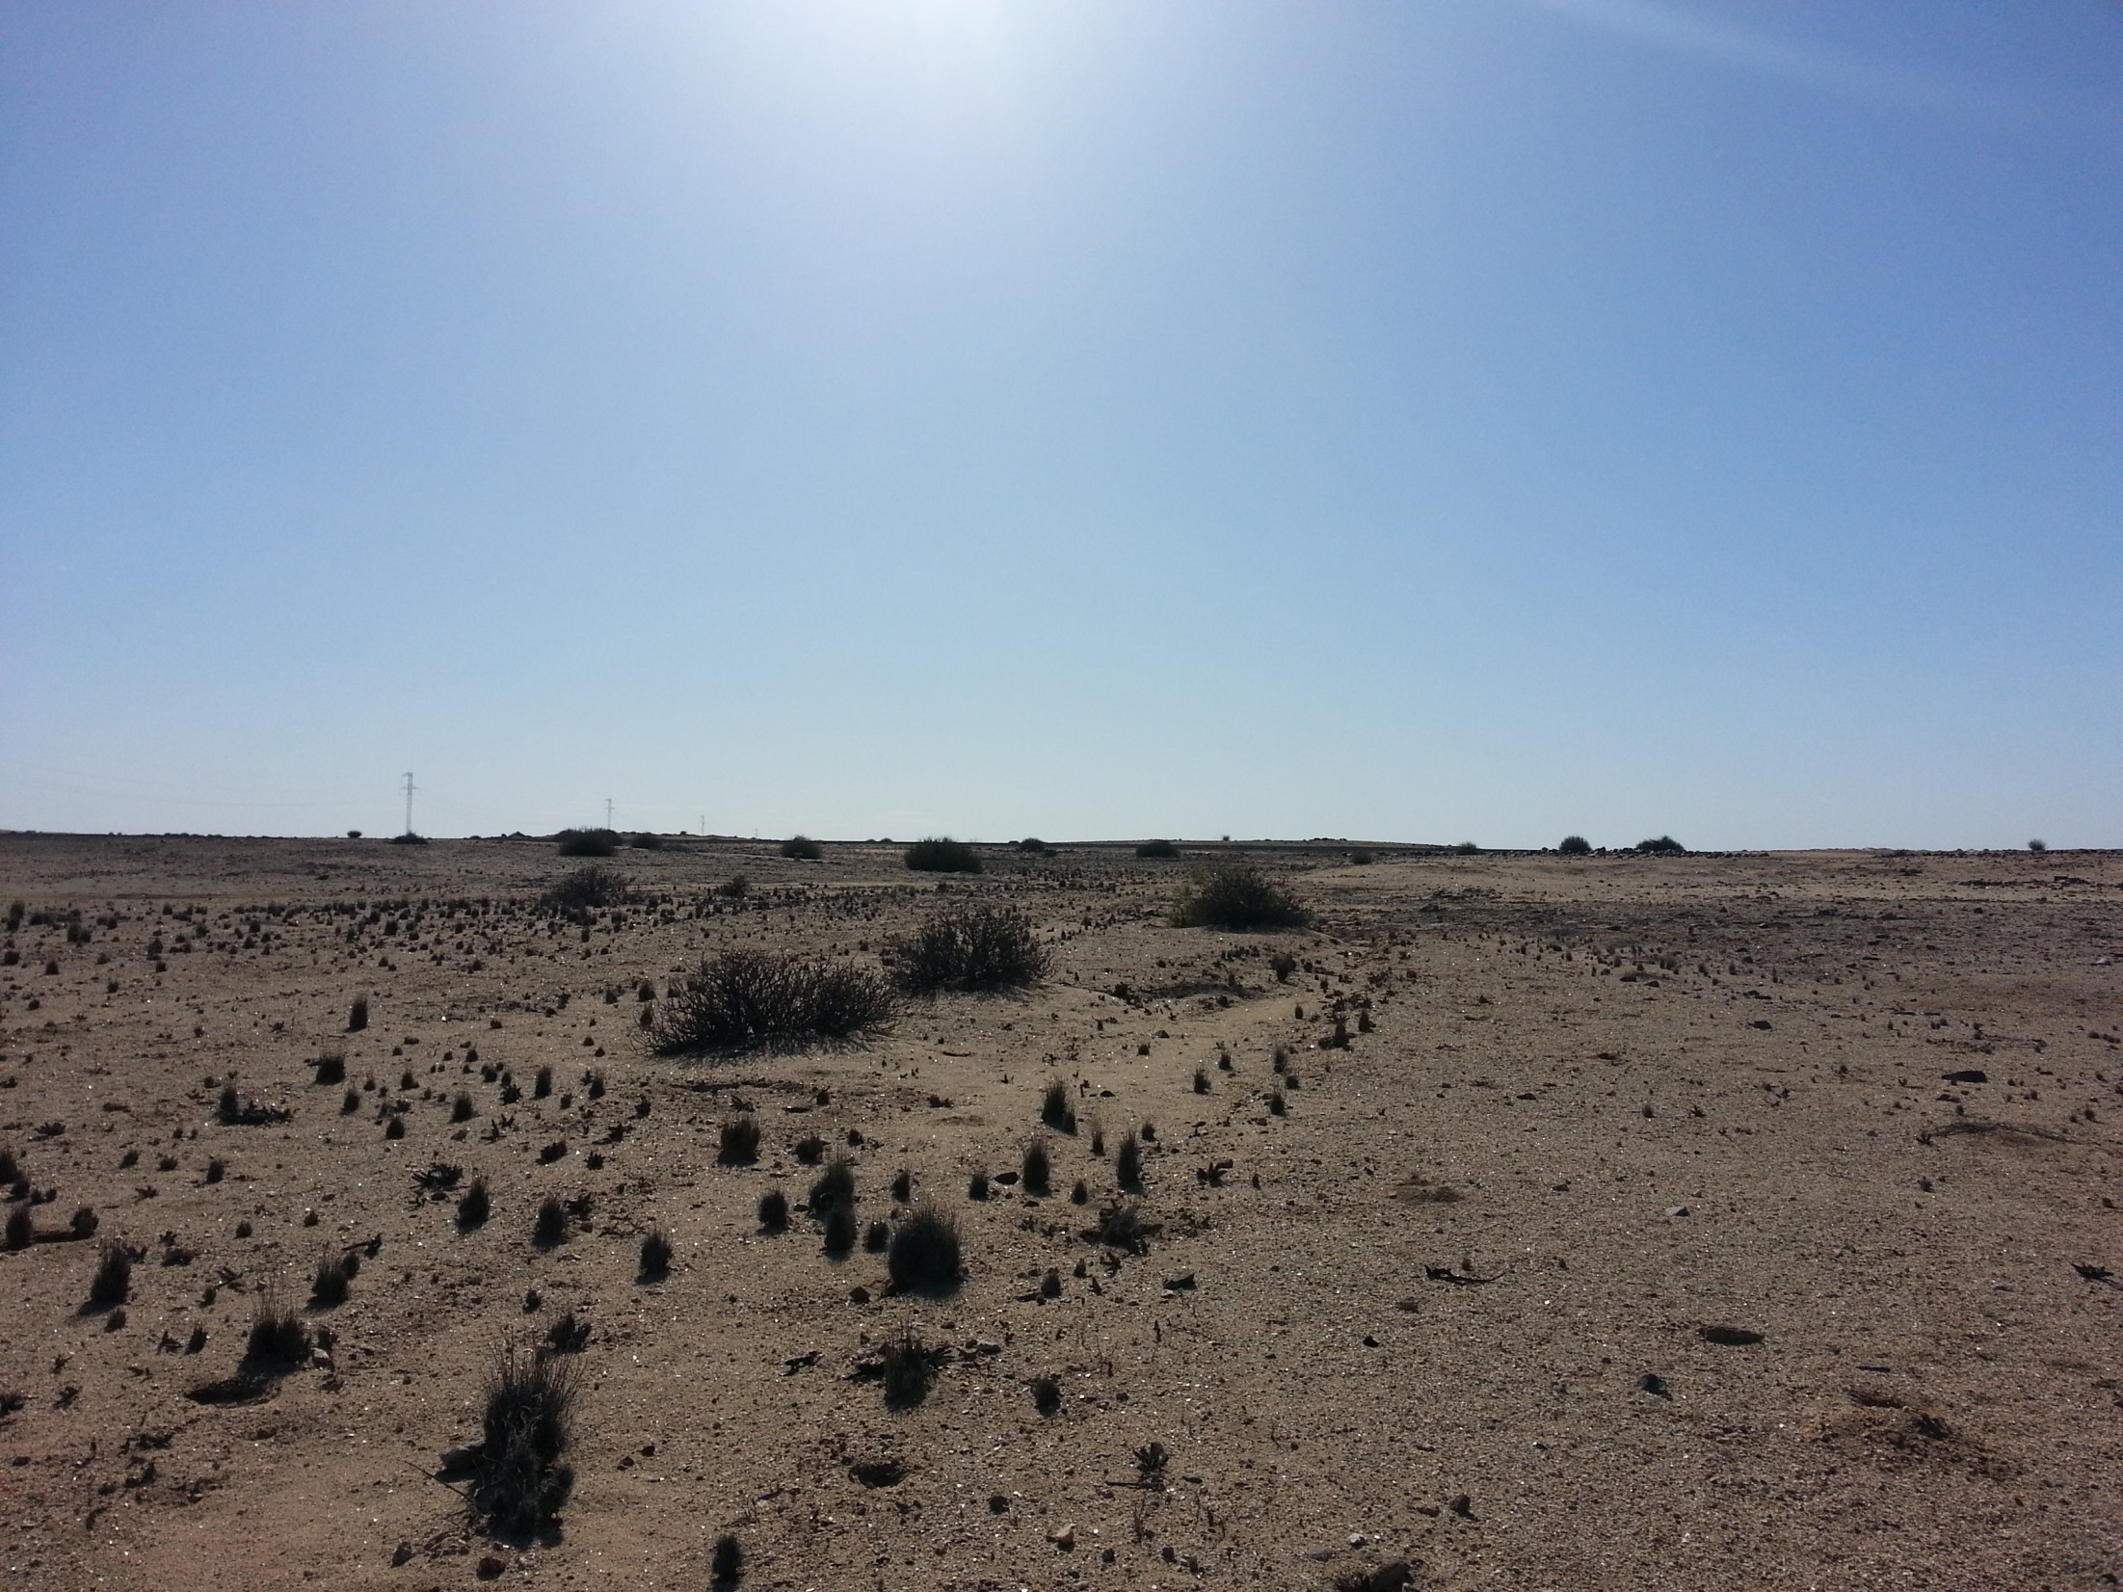
SOLAR THERMAL TECHNOLOGY ROADMAP - NAMIBIA
Zivayi Chiguvare
Director: Namibia Energy Institute (NEI)
Namibia University of Science and Technology (NUST),
Private Bag 13388 Windhoek Namibia
Phone: 00264 61 207 2154 Fax: 00264 61 207 2059,
http://www.nust.na/ ; nei@nust.na

Slide 2
Outline
Introduction
Mission and Vision of the STTP
Solar thermal technology roadmap
Analysis
Stakeholder roles
Conclusions
A Vision of Namibia’s Solar Thermal Energy Future

Slide 3
Introduction
Man needs food and thermal comfort;
Man works for these – from birth to death;
Man harnesses these locally and from afar;
Man shows love through provision of food and thermal comfort;
Man fights, and protects these with all they have;
Technology eases their harnessing, storage, transmission, protection, and provision.
Irresponsible technology threatens man’s livelihood.

Slide 4
Solar Thermal Technology Platform
May 2013: the first introduction to solar thermal technology platforms was given
November 2013, the discussions were consolidated, culminating in a draft vision document in this respect
Some committed to become members of the STTP
Workshops: 4 Dec 2014; May 2015
Roadmap
Major investments are urgently required for sustainability

Slide 5
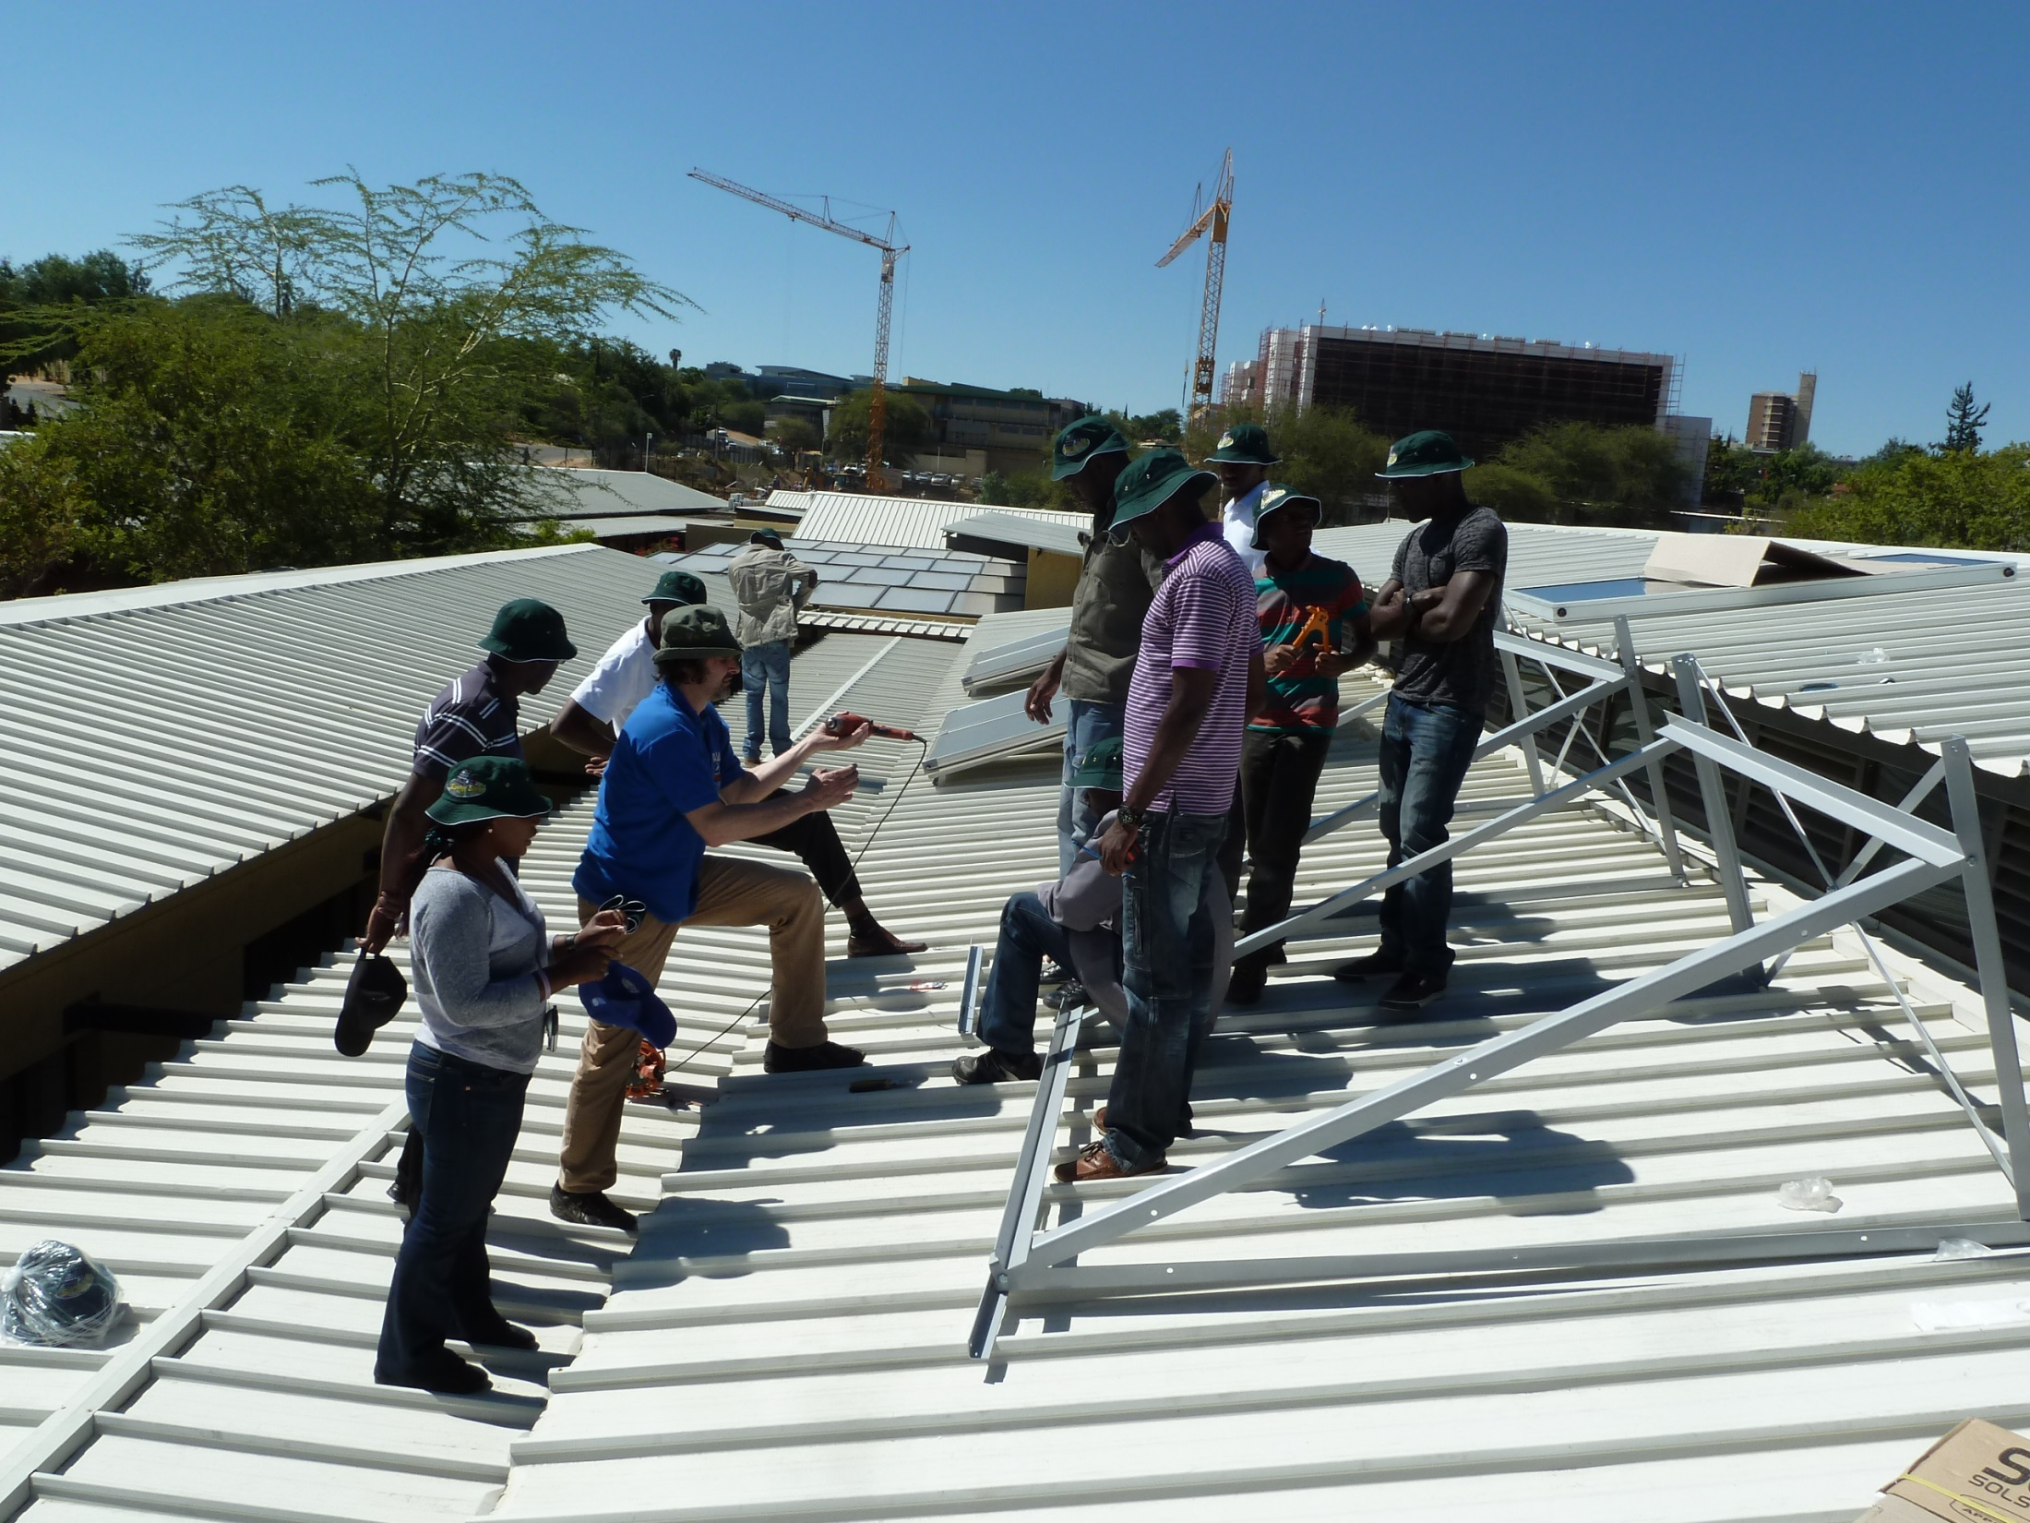
Some good moments in SOLTRAIN

Slide 6
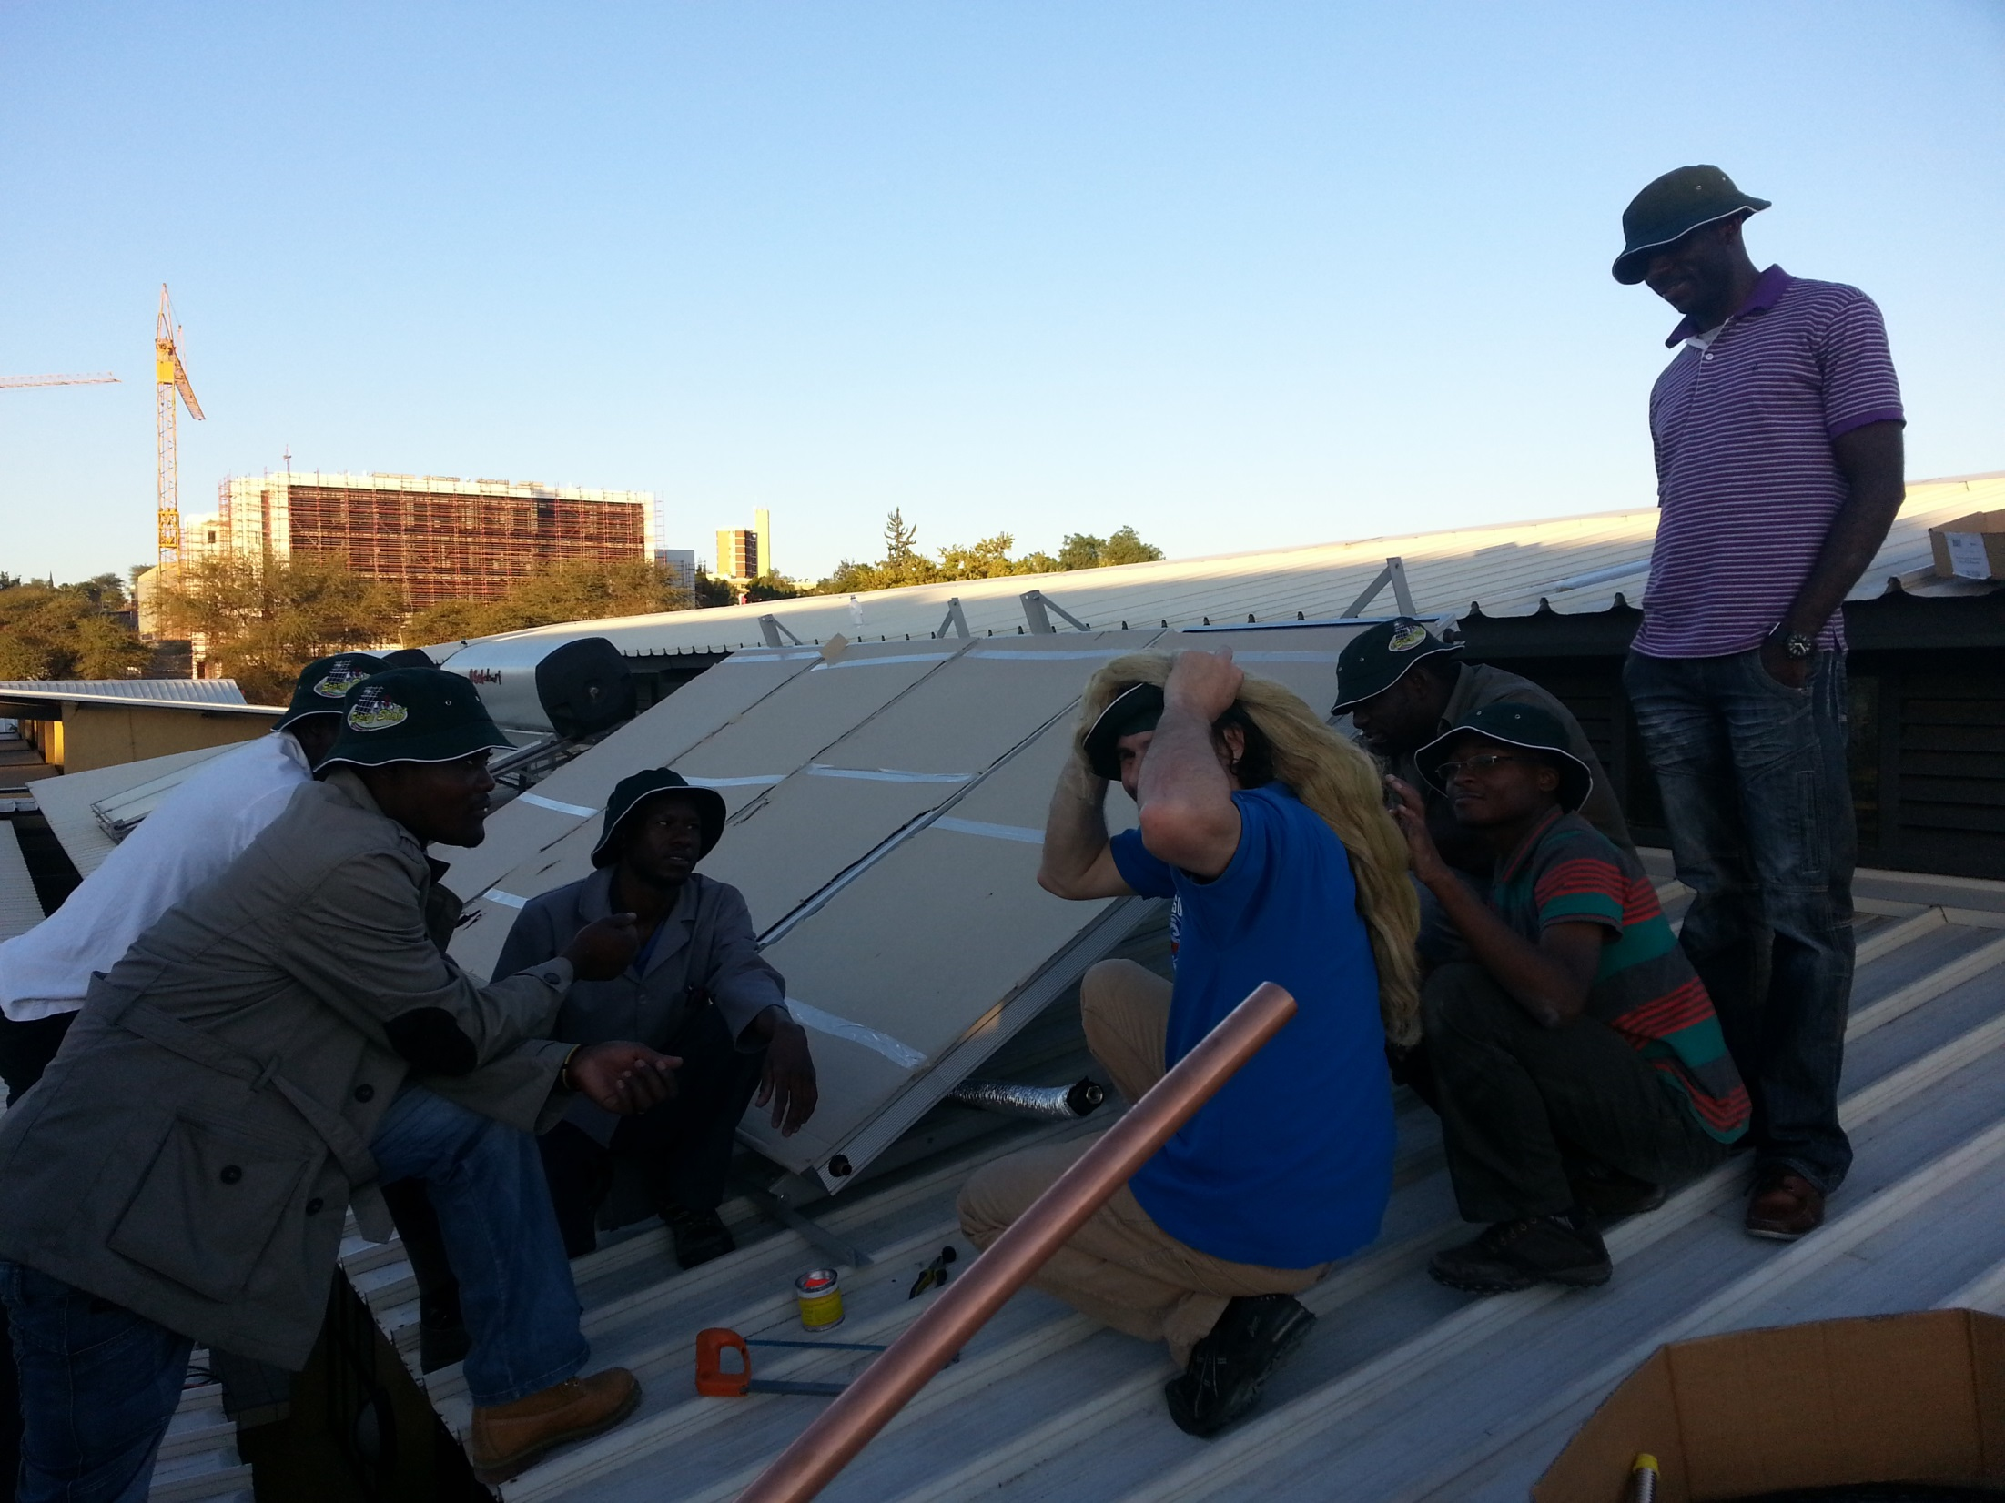
Some good moments in SOLTRAIN

Slide 7
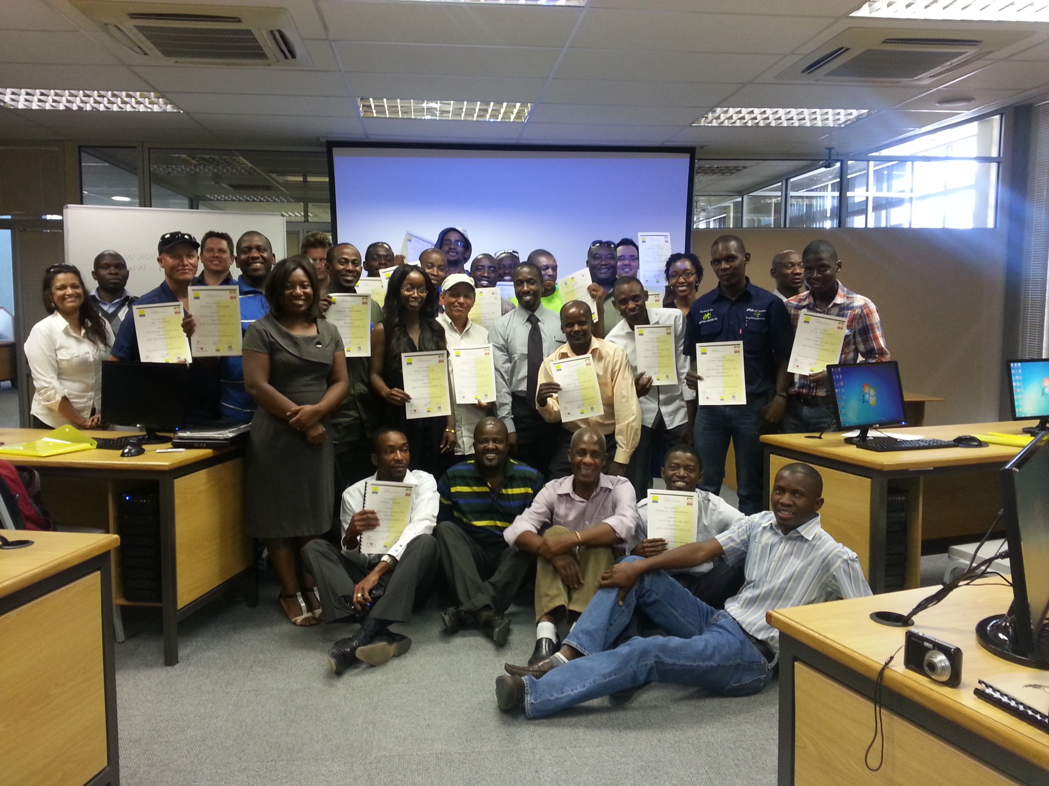
Some good moments in SOLTRAIN

Slide 8
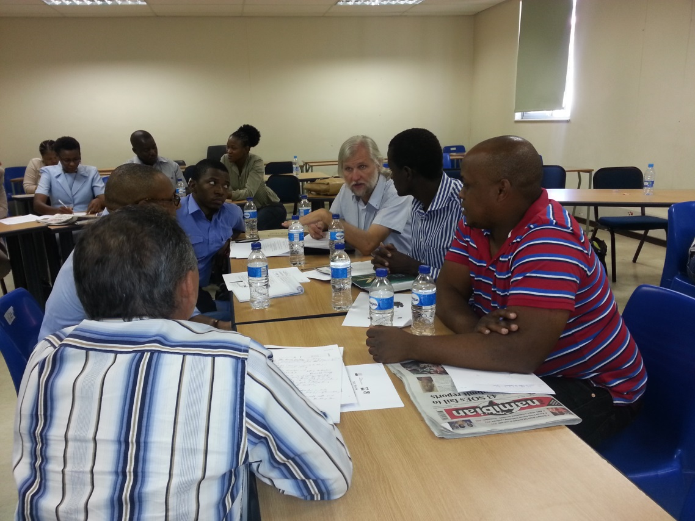
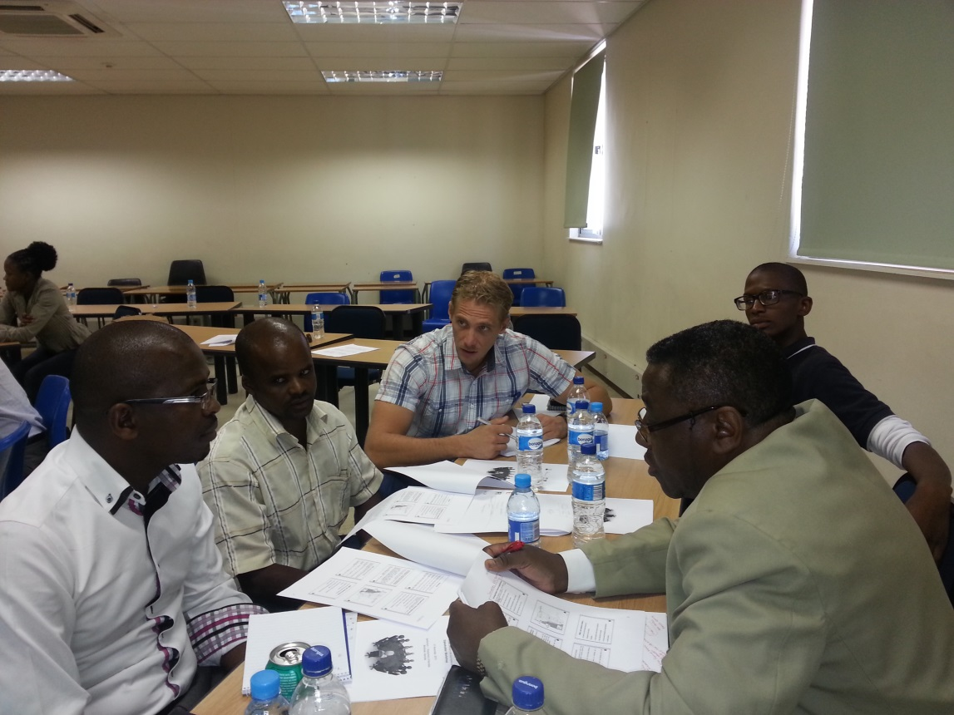
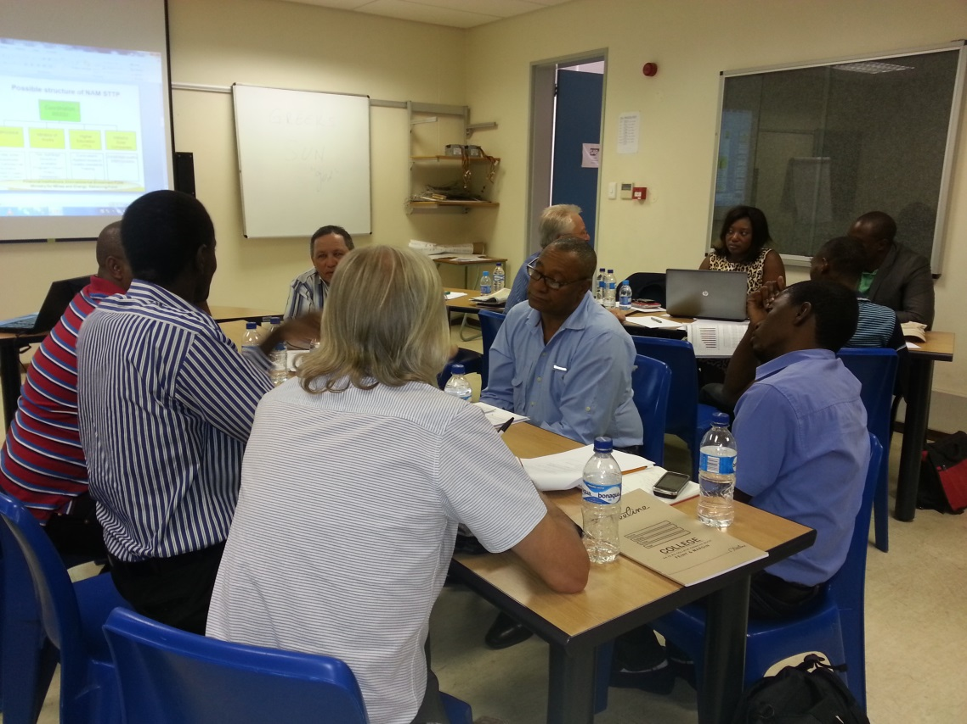
SOLTRAIN Workshops

Slide 9
Mission
Mission of Solar Thermal Technology Roadmap 2030:
To outline pathways to achieve a low-carbon economy in Namibia, in line with the universal energy access, energy security, environmental and economic goals of the Namibian Government.
To enhance the quality of life of Namibians through the provision of a sustainable and quality-assured solar thermal technology value chain
It is an initiative of the (SOLTRAIN) Project.
A Vision of Namibia’s Solar Thermal Energy Future

Slide 10
Mision
The Solar Thermal Technology Platform has defined its mission, i.e., to achieve a fully functional 0.5 m² of flat plate solar thermal collector installed capacity per inhabitant in Namibia by 2030 (approximately 0.35 kW thermal equivalent).
By achieving the said penetration of solar thermal technologies, some 1.5 million m² of collector area with a thermal output equivalence of approximately 525 MW would be available by 2030.
Major energy savings envisaged

Slide 11
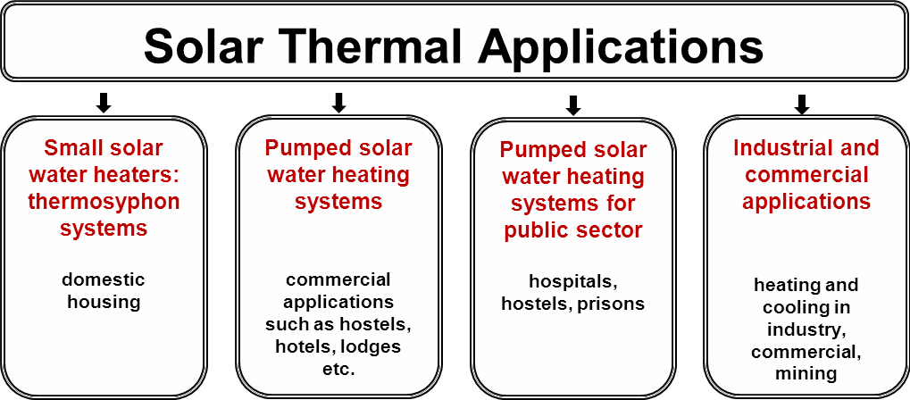
Vision
The Namibia STT roadmap aims to achieve the installation of 0.5 m² of solar thermal collectors per inhabitant, which translates to about1.5 million m², by 2030,.
An Active Solar Thermal Technology Platform Needed

Slide 12
Solar Thermal Technology Roadmap
Namibia’s solar thermal industry offers:
Thermo-syphon systems for domestic houses (2 – 4 m² per system);
Thermo-syphon systems for commercial operations, including tourist establishments and lodges (2 – 4 m² per system);
Solar combi-systems (pumped systems) which combines hot water preparation and space heating for domestic houses (10 – 20 m² per system);
Pumped systems for multi-family houses, hotels, hospitals etc. (20 – 100 m² per system);
Cooling and air-conditioning of larger offices, hotels etc. (50 – 500 m² per system);
Industrial applications, including the desalination of sea water (50 – 500m² per system); and
Solar cooking systems.
A Vision of Namibia’s Solar Thermal Energy Future

Slide 13
Daily energy production of SWHs (kWth.h)
Technology | Flat plate | Flat plate | Evacuated
Configuration | Thermo-syphon | Indirect active | Indirect active
Overall size (m²) | 1.98 | 1.87 | 2.85
Absorber size (m²) | 1.98 | 1.72 | 2.85
Maximum efficiency | 0.74 | 0.61 | 0.57
Estimated cost (Jan 2016) (US$) | $4,000 | $4,600 | $6,000
Energy production (kW.h/day): – Insolation 6.5 kW.h/m²/day (Most parts of Namibia receive above 2400 kWh annually) | 8.8 | 7.1 | 9.9
Source: RENEWABLES GLOBAL STATUS REPORT 2009 Update.
Cost of water heater – about USD2000/m²

Slide 14
Sector-specific solar thermal targets until 2030
Sector | Description of thermal energy requirements (units) | Estimation of solar thermal collector area to satisfy requirements (m²) | Estimated total energy produced (kWthh) | Estimated cost of equipment (US$2000/m²)
Mass housing project | SWHs for additional 185 000 domestic houses | 400 000 | 642 400 000 | 800 000 000
Private one-family housing stock | replacement of most domestic electric water heaters by SWHs | 600 000 | 963 600 000 | 1200 000 000
Private multi-family housing stock | 20 000 | 100 000 | 160 600 000 | 200 000 000
Private commercial establishments, incl. lodges | 1 000 | 20 000 | 32 120 000 | 20 000 000
Hotels, hospitals, student homes | 180 hotels, 343 hospitals and clinics, etc. | 60 000 | 96 360 000 | 120 000 000
Solar air- conditioning and cooling | Office buildings | 20 000 | 32 120 000 | 40 000 000
Systems for industrial and mining applications | Low temperature applications, < 200°C | 200 000 | 321 200 000 | 400 000 000
Domestic and commercial | Solar cooking at 1m² per family | 100 000 | 160 600 000 | 20 000 000
TOTAL |  | 1 500 000 | 4 818 000 000 | 4 240 000 000

Slide 15
Analysis
The vision is based on the assumption of wide spread accessibility to clean piped water. The ambitious target of 0.5m² per inhabitant will be based also on cumulative installation and total population.
The power provided through solar thermal technologies of this nature avoids the generation of electricity by an equivalent 550 MW generator operating continuously.
If implementation is started at the beginning of 2017, there are 13 years till 2030. This implies an average installation of 115 385 m² of collector area per year, at an average cost of US$326.2 million. (~7% of Namibia’s 2015/16 annual budget)
Government alone may not be in a position to fully finance this venture, therefore private and other donor participation is encouraged.
Structured investments are urgently required

Slide 16
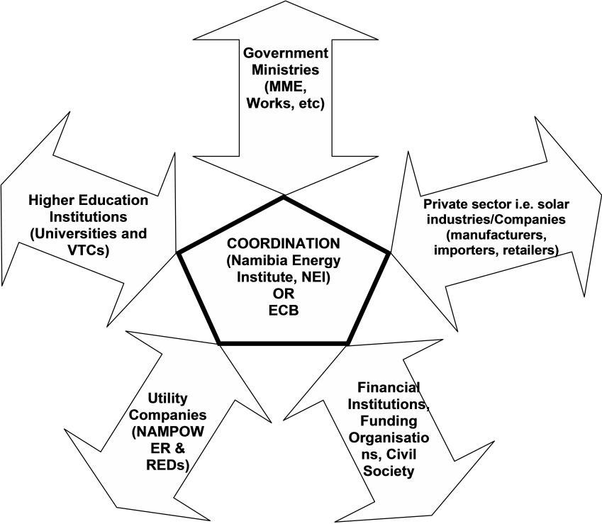
Stakeholder roles
Proper coordination is essential

Slide 17
A symbol of hope for universal energy access in Namibia

Slide 18
Stakeholder roles
integrate solar thermal technologies into own curricula, offer post-graduate programmes solar thermal tech, and engage in applied research
Policies; funding
developing and implementing cost-effective end-use systems
integrate solar thermal technologies into own demand side management programmes
Provide attractive financial support to encourage more users to apply for loans
All stakeholders should play their part diligently

Slide 19
Research and Development
R&D as an input into innovation is vital for the success of the solar thermal technology roadmap.
This will allow the creation of an innovative atmosphere in the solar thermal field, in public institutions as well as in industry.
The vision considers a strategic research agenda to ensure long-term sustainability of the sector.
The government should consider supporting and budgeting for research and demonstration programs.
R & D is essential for success

Slide 20
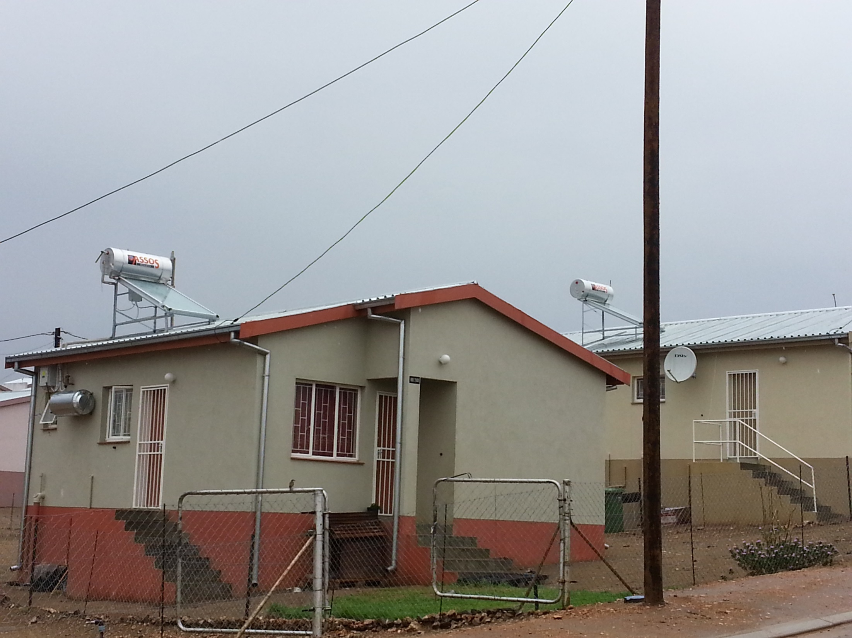
SWH for Mass Housing
Real savings in flagship districts to motivate others

Slide 21
Conclusions
Solar thermal technology platform formulates and coordinates the implementation of the roadmap
Regional impact can be integrated through SACREEE
Only through a global effort can humans be able to reduce the impact of energy provision on climate change.
Every one has a part to play!

Slide 22
Conclusions
Only through a global effort can humans be able to reduce the impact of energy provision on climate change.
Play your part!

Slide 23
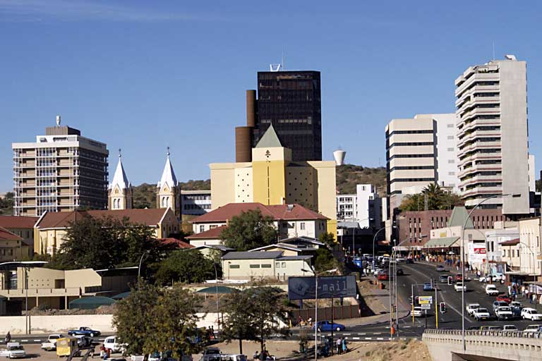
THANK YOU

